Slide 1

SYNOPSIS Presentation
on
DOCMEET
by
Anup Kumar Mahto 202410116100038
Ashwini Kumar Katiyar 202410116100044
Anubhav Vaish 202410116100037
Anshu Nishad 202410116100033
Session:2025-2026 (III Semester)
Under the supervision of
Dr. Vipin Kumar
Department Of Computer Applications
KIET GROUP OF INSTITUTIONS, DELHI-NCR, GHAZIABAD-201206

Slide 2



DocMeet: Revolutionising Doctor Appointments with Virtual Care
Connecting patients & doctors ,book appointment, Symptoms Checker, Medical Chatbot
Notes:
2

Slide 3
Project Overview: Addressing the Healthcare Gap
Patient Challenges
Doctor Challenges
Long wait times for appointments
Inefficient appointment management
Limited access to specialist care
Difficulty in patient flow optimization
Geographical barriers to healthcare
Administrative burdens
Notes:
3

Slide 4

Project Overview and objective
Three Distinct Panel:
Doctor Panel (manage profile, earning)
Patient Panel (book appointment)
Admin Panel (manage & create doctor profile)
More Section
TYPE Symptom
(Disease, Description, Precautions , diet).
Medical Chatbot
SDG 9: Industry, Innovation and Infrastructure.
.
Notes:
4

Slide 5


Project Scope: Empowering Doctors
Register & Profile Creation
Appointment Management
Doctors can easily register and build detailed profiles, showcasing their specialties, experience, and availability.
Effortlessly manage appointment schedules, view upcoming consultations, and track patient history within an intuitive interface.
DocMeet streamlines the professional life of doctors, allowing them to focus more on patient care and less on administrative tasks.
Notes:
5

Slide 6

Patient Panel: Convenient Healthcare Access
The patient panel is designed for ease of use and maximum convenience, allowing individuals to:
Browse Doctors: Explore detailed doctor profiles, filter by specialty, and read reviews to make informed choices.
Book Appointments: Schedule appointments 24/7 at their convenience, viewing real-time availability.
Notes:
6

Slide 7



Admin Panel: Seamless System Management
User Oversight
Workflow & Scheduling
Monitoring & Reports
Admin create doctor profile, including doctor approvals and patient account management, ensuring platform integrity.
Manages appointment workflows, resolves scheduling conflicts, and ensures smooth operations for both doctors and patients.
Monitors system usage, generates performance reports, and gains insights for continuous platform improvement and efficiency.
The admin panel is the central control hub, ensuring DocMeet operates efficiently and securely for all users.
Notes:
7

Slide 8



MERN Stack Development: Methodology and Tools
MERN Stack Methodology
Backend & Database Tools
Frontend & Development Tools
Utilizing the MERN stack (MongoDB, Express.js, React.js, Node.js) for a robust, full-stack JavaScript development approach, enabling end-to-end efficiency.
Node.js with Express.js for scalable server-side logic and RESTful APIs, coupled with MongoDB as a flexible NoSQL database for efficient data management.
React.js for building dynamic and responsive user interfaces, complemented by modern development tools VS Code for streamlined workflows.
Our project development prioritizes modularity, scalability, and maintainability, ensuring a high-quality and future-proof application.
Notes:
8

Slide 9
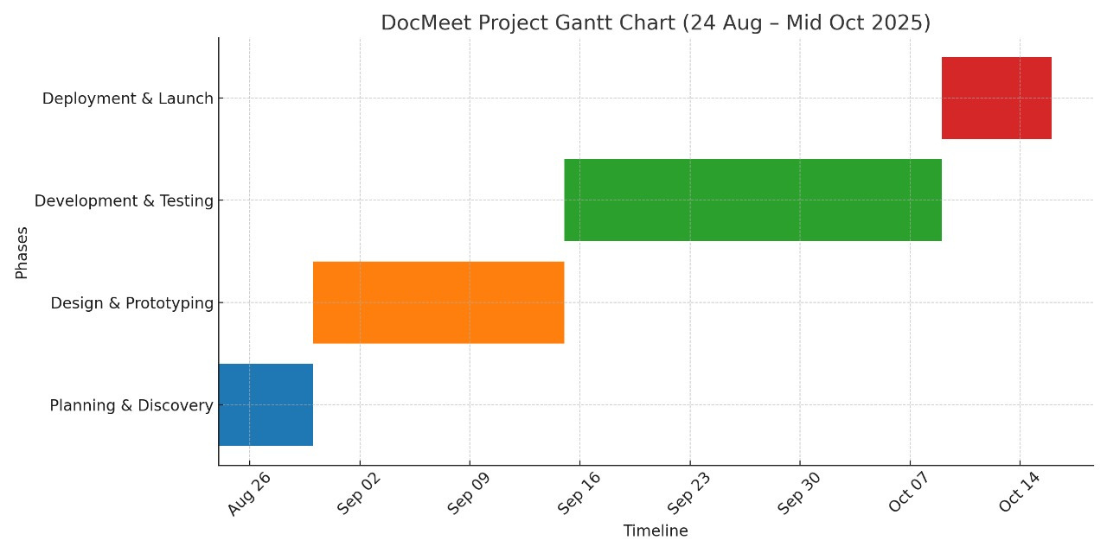

Slide 10

The Future of Healthcare is Here with DocMeet
We are dedicated to bridging the gaps between doctors and patients through innovative technology.
Join us in transforming healthcare delivery with virtual care.
Let’s make healthcare accessible, efficient, and patient-centric, one virtual appointment at a time.
Notes:
10

